Slide 1



Mart Inventory Application
Presented By-
Palash Kardhekar
Bhavesh Kumar Verma
http://www.free-powerpoint-templates-design.com

Slide 2
Points to be discussed
Screenshots
Specification
Conclusion
Introduction
Motivation
Disadvantages
Future Enhancement
References
Advantages
S/W and H/W
Requirement
Objectives
UML Diagrams

Slide 3
Introduction
Mart Inventory is a web application. It provides a platform that will automate various tasks associated with handling product catalog and Execution of proper billing system better organizing the stored information and optimum performance. Helping the business to ensure smooth working of the process that provides the function and features to authenticate and identify the sales person and provide then with easy, intuitive, personalized and user-customizable web-interface for facilitating access to information and services that are of primary relevance and interests to the sales person

Slide 4
Motivation
Now a days, market is shifting towards online mode and customer wants to access and buy products fast and in efficient way so by ensuring this features to groceries also.
Due to pandemic, the Mart and grocery faces multiple difficulties for managing as well as selling required products to the customers.
customers and sellers has to go through various procedure in order to change or return a products.
customers and owners can not get all the feedbacks that are necessary for the enhancement of their businesses. Hence, they require a proper platform for communication.
Mart Inventory will reduce mart owner as well as user’s efforts of following various procedures ,manual efforts to return or change a product, easy communication would be ensured by doing transaction in front of cutomers.

Slide 5
Objectives
:The main purpose of this system, is to reduce the consumption of time during maintaining the records of Inventory. Separate divisions are providing to maintain the records of stocks. Our System also procure an easy way not only to automate all functionalities of a mart, but also to produce bill of purchased products
In other words, our Mart Inventory application has, following objectives:
Simple database is maintained.
Easy operations for the operator of the system. User interfaces are user accommodating and attractive; it takes very less time for the operator to use the system.
The aim is to provides a platform that will automate various tasks associated with handling product catalog & execute proper billing system.

Slide 6
Technology Used:
Front End: React
Back End: Java Spring Boot API.

Slide 7

UML Diagrams

Slide 8
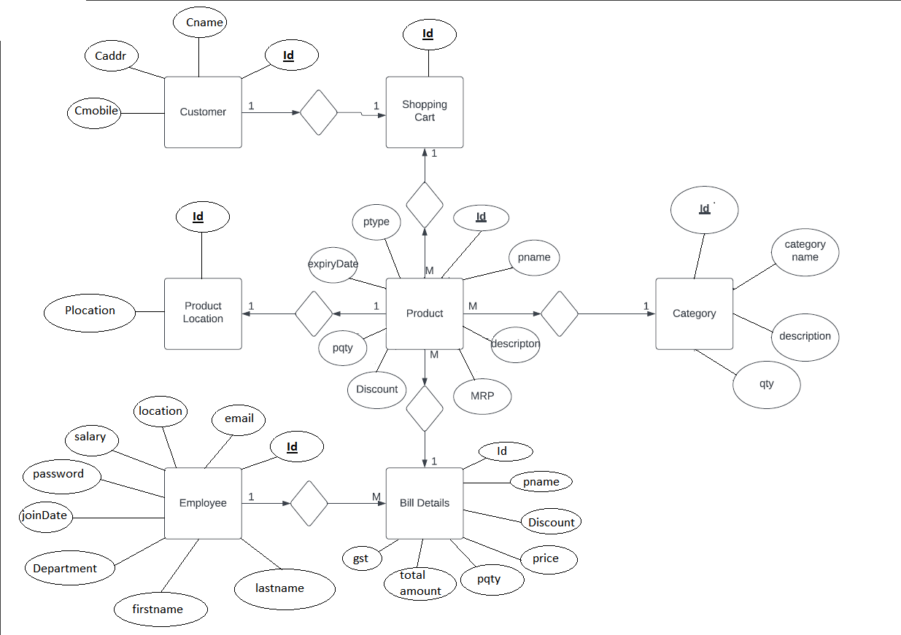
E-R Diagram

Slide 9
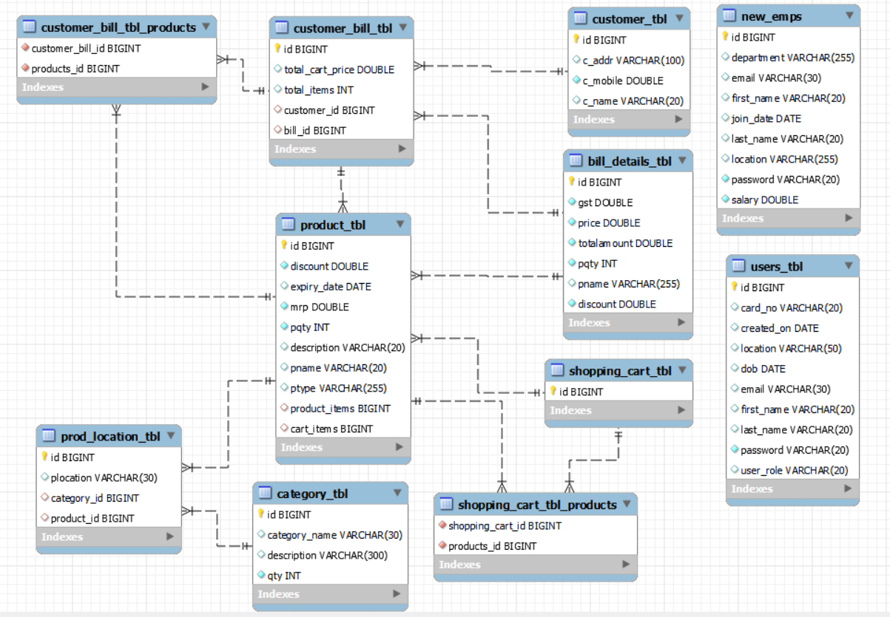
E-R Diagram(MySQL Auto generated)

Slide 10
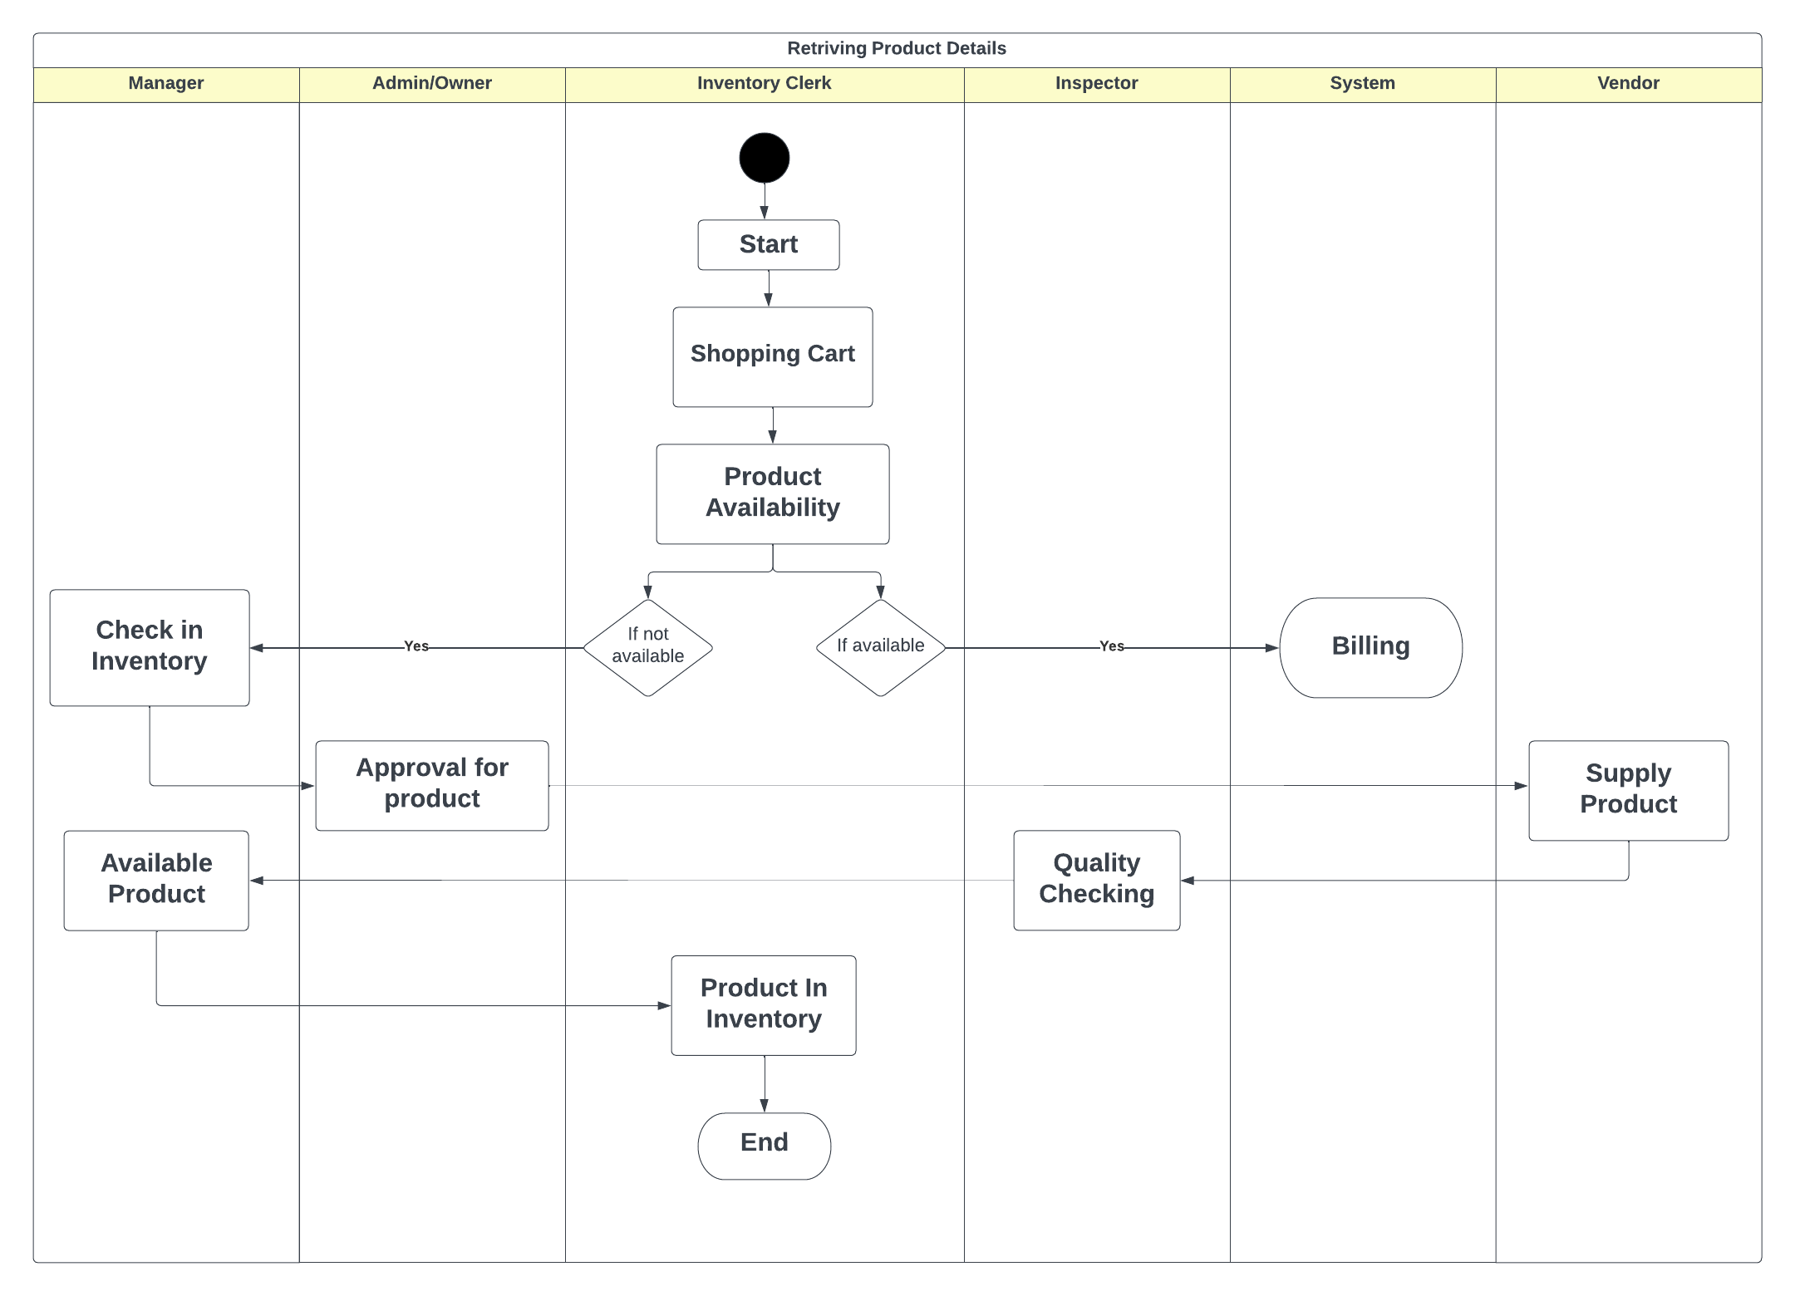
Activity Diagram

Slide 11
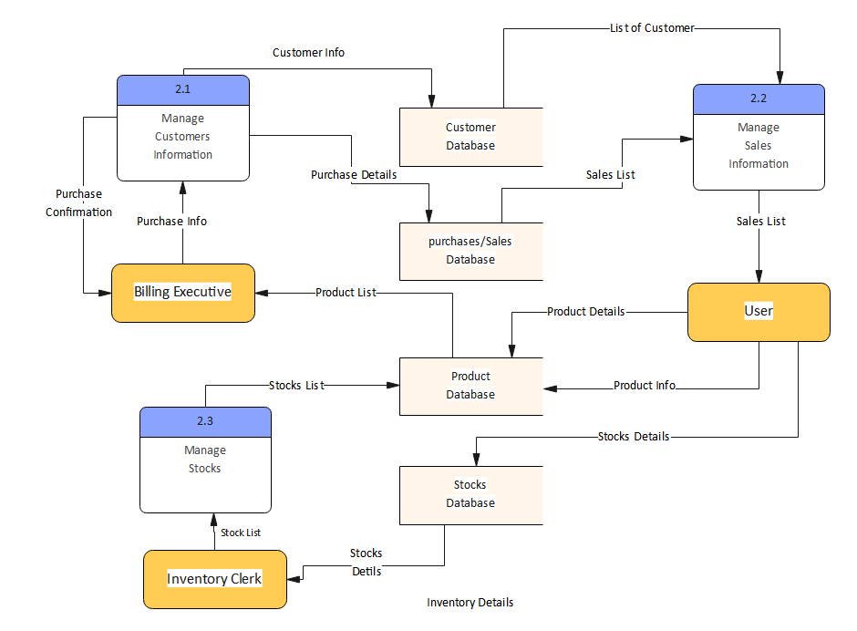
DFD Diagram
Level Two

Slide 12
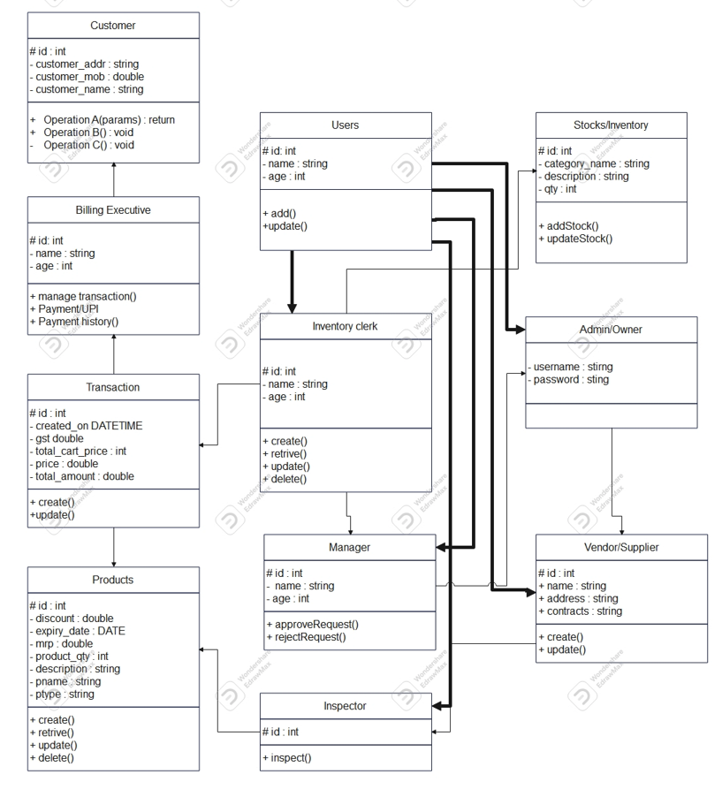
Class Diagram

Slide 13
Screen Shots

Slide 14
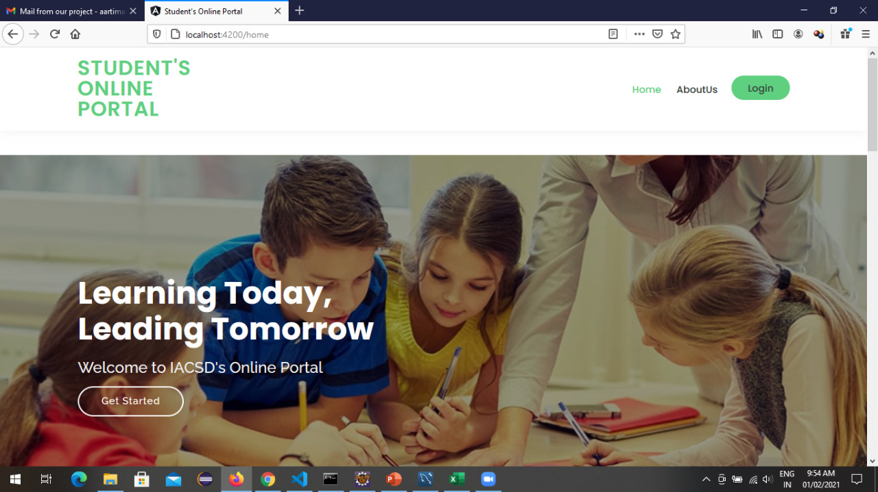
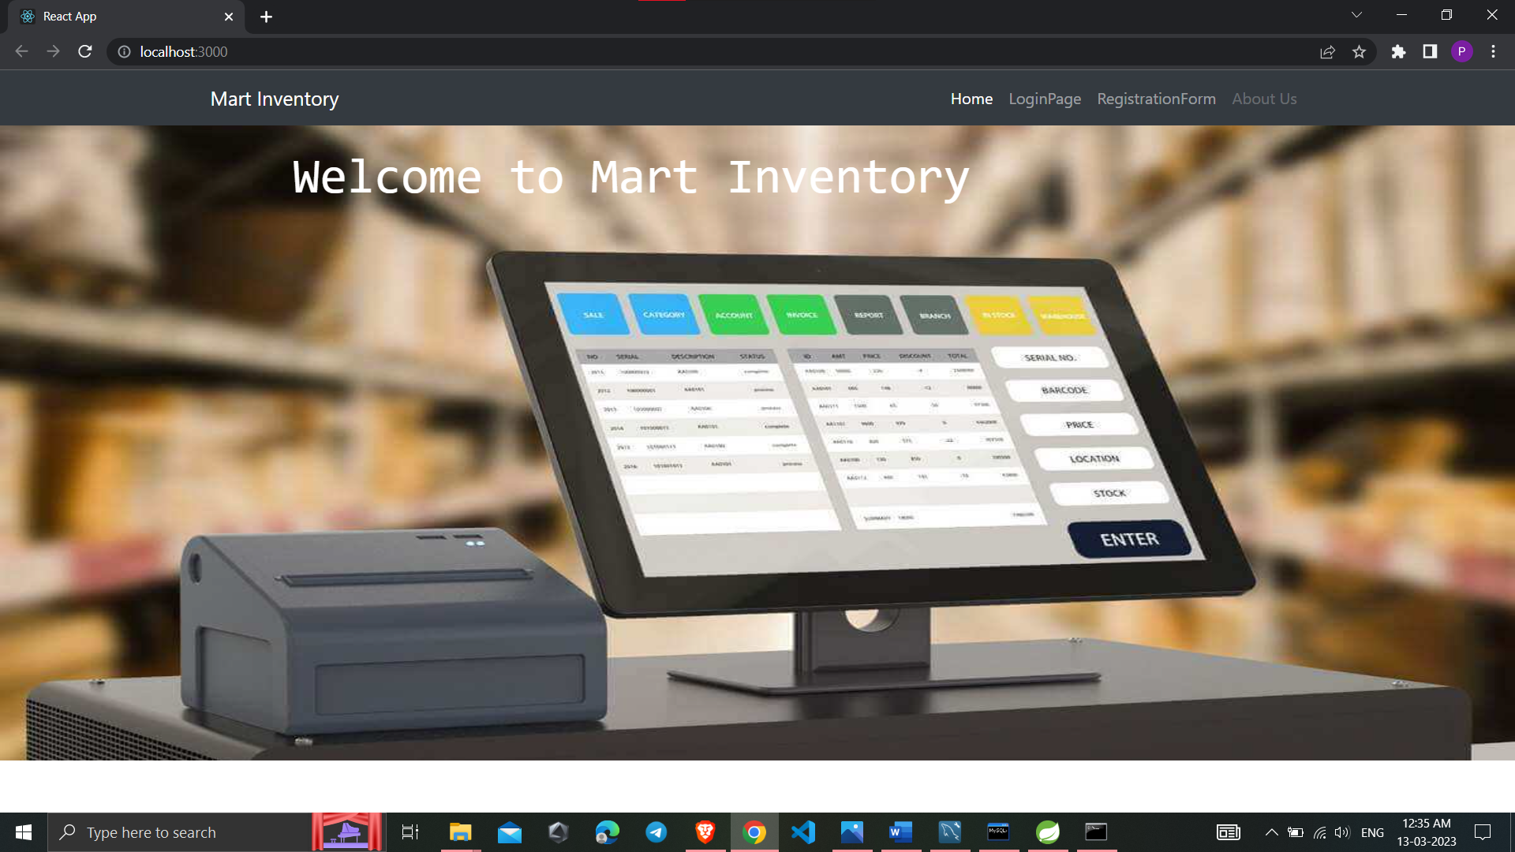

Slide 15
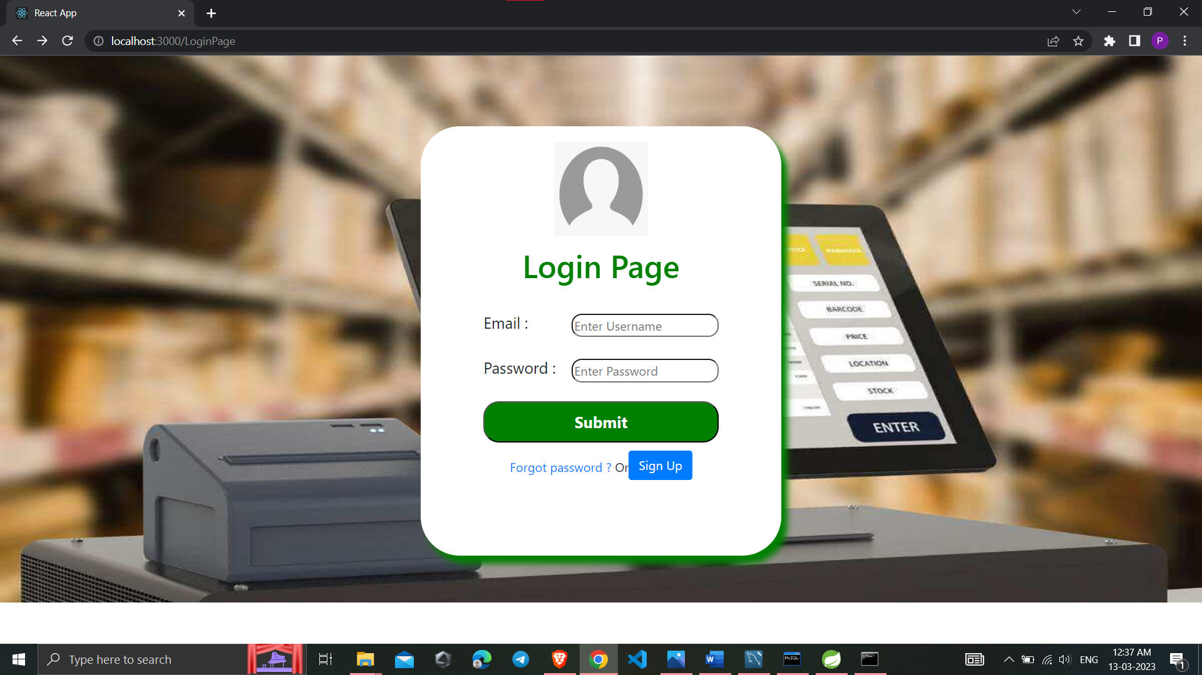

Slide 16
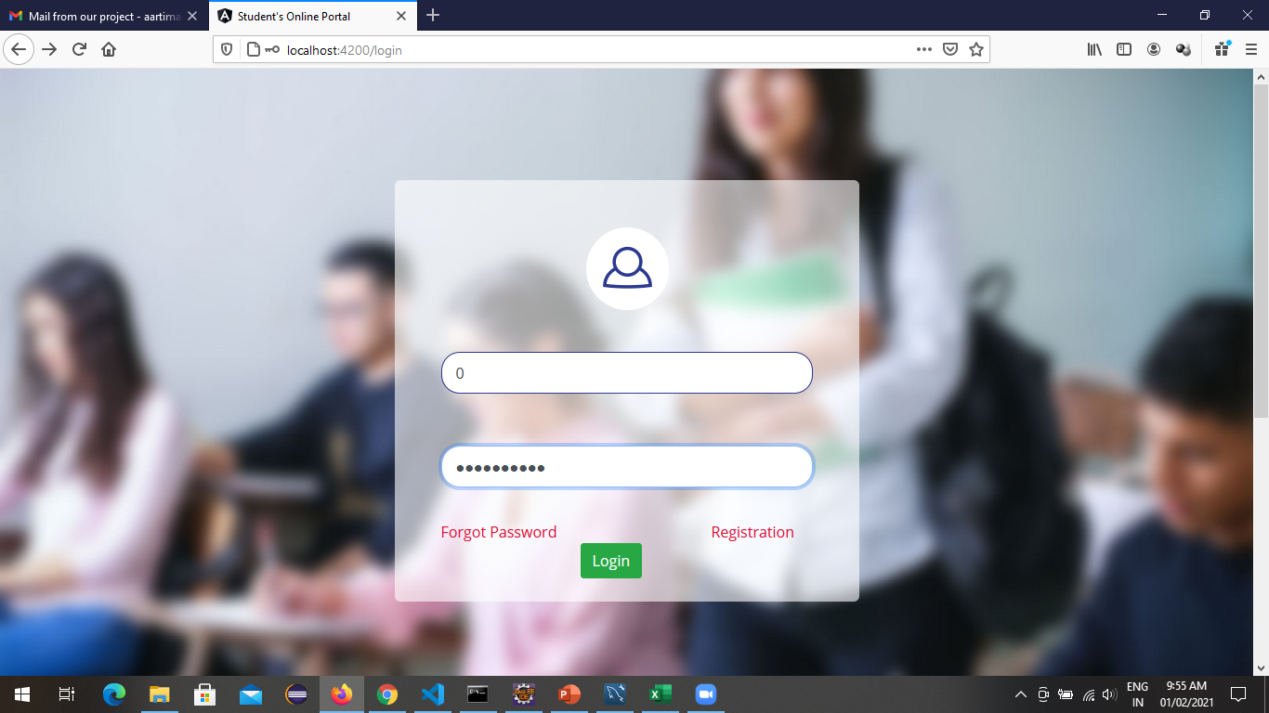
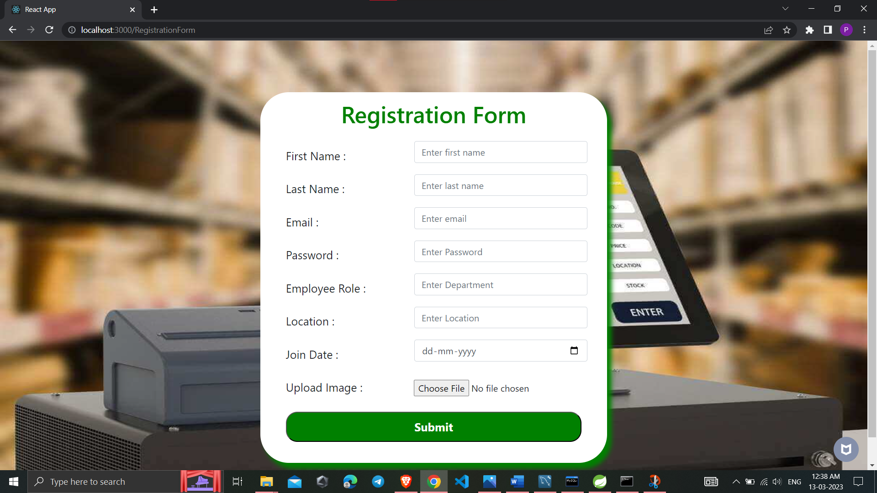
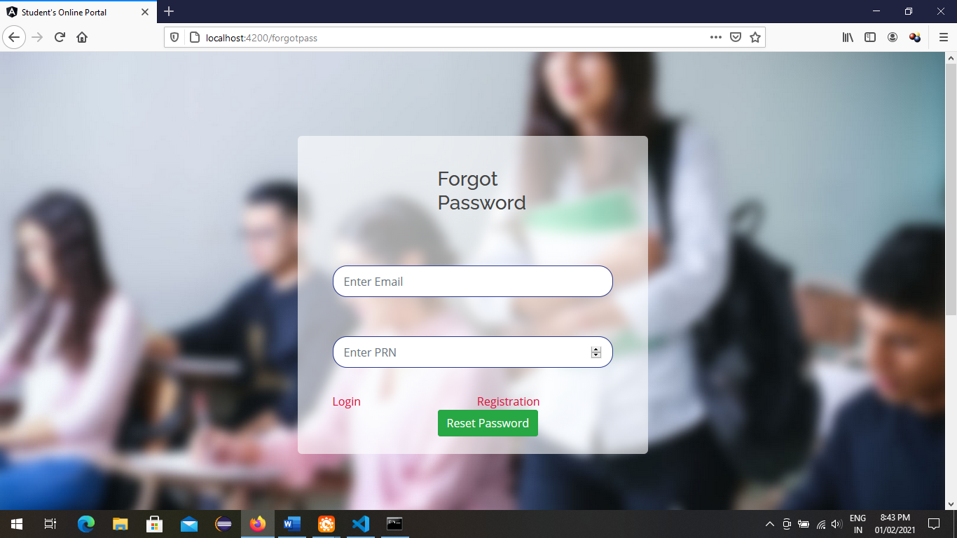
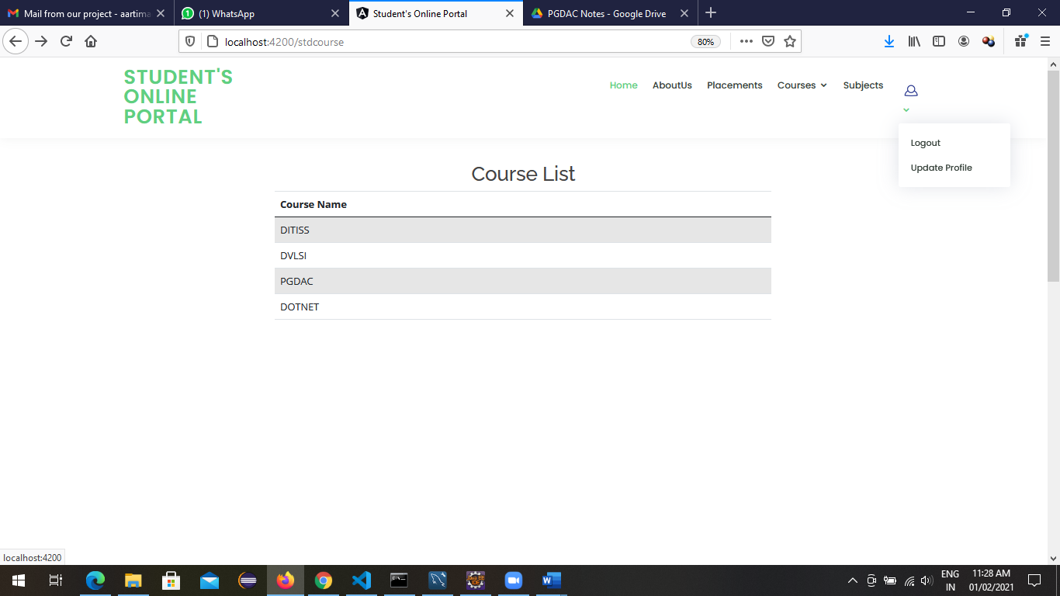
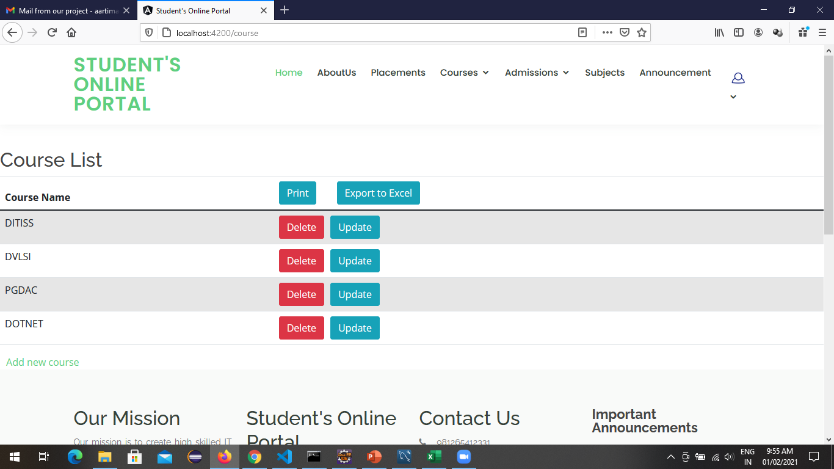

Slide 17
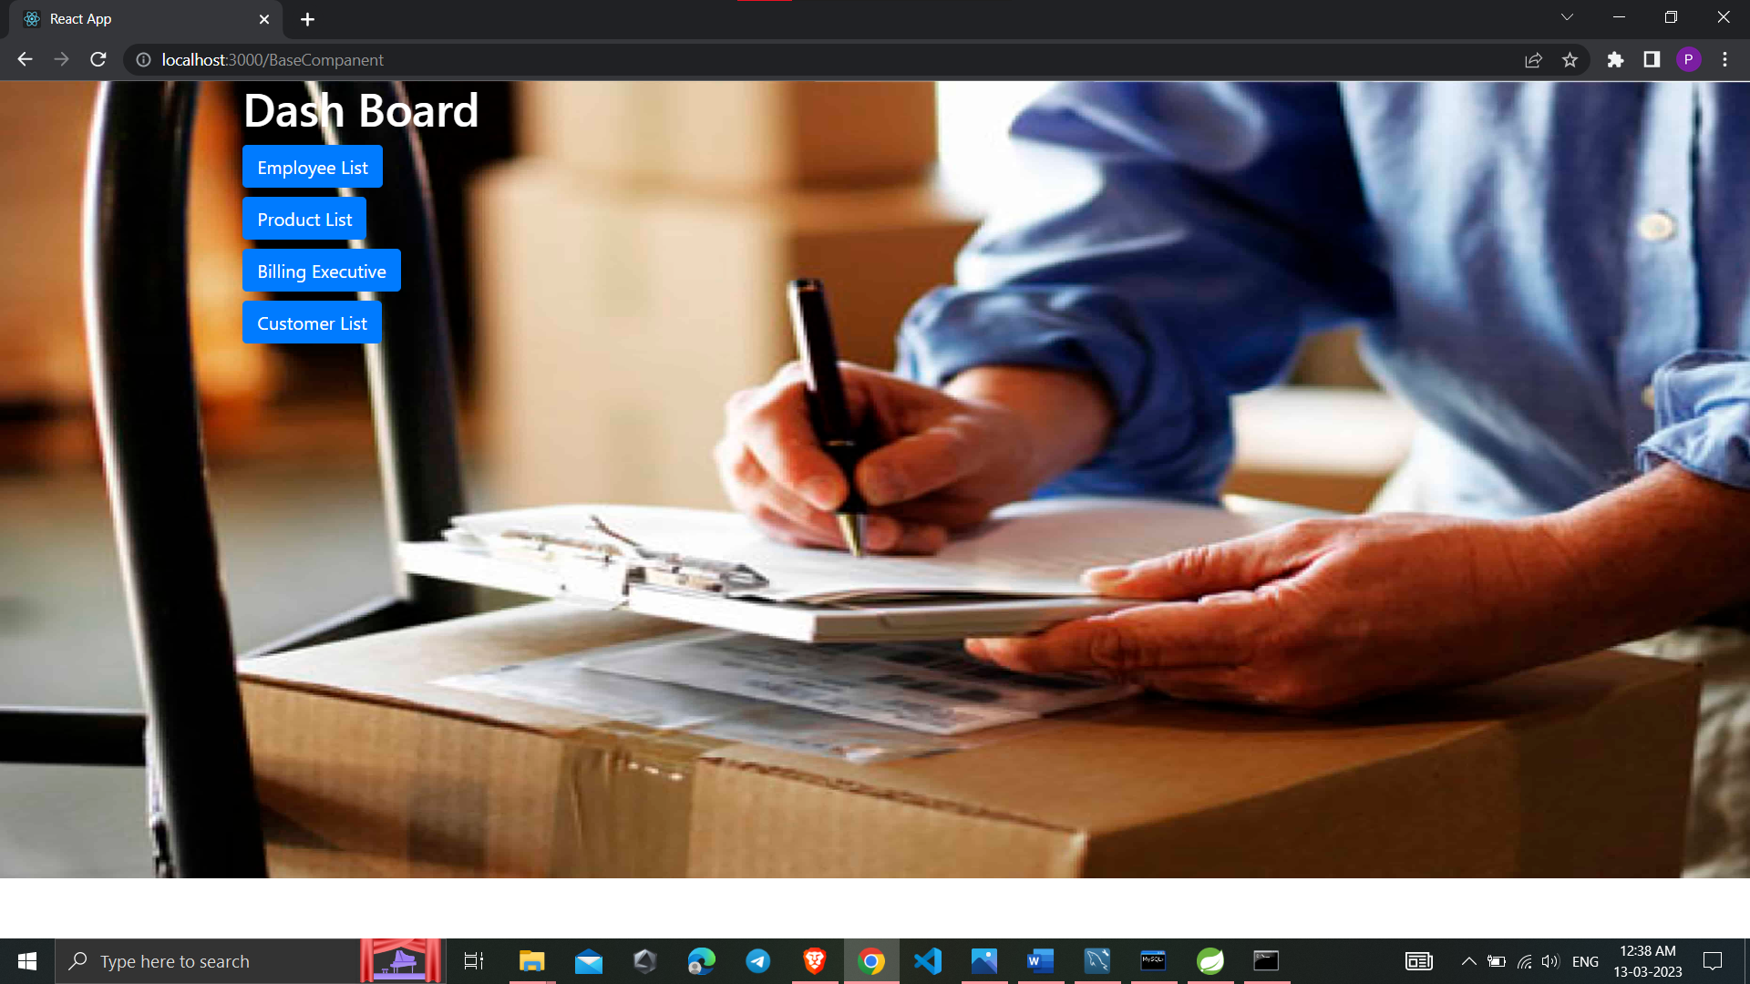

Slide 18
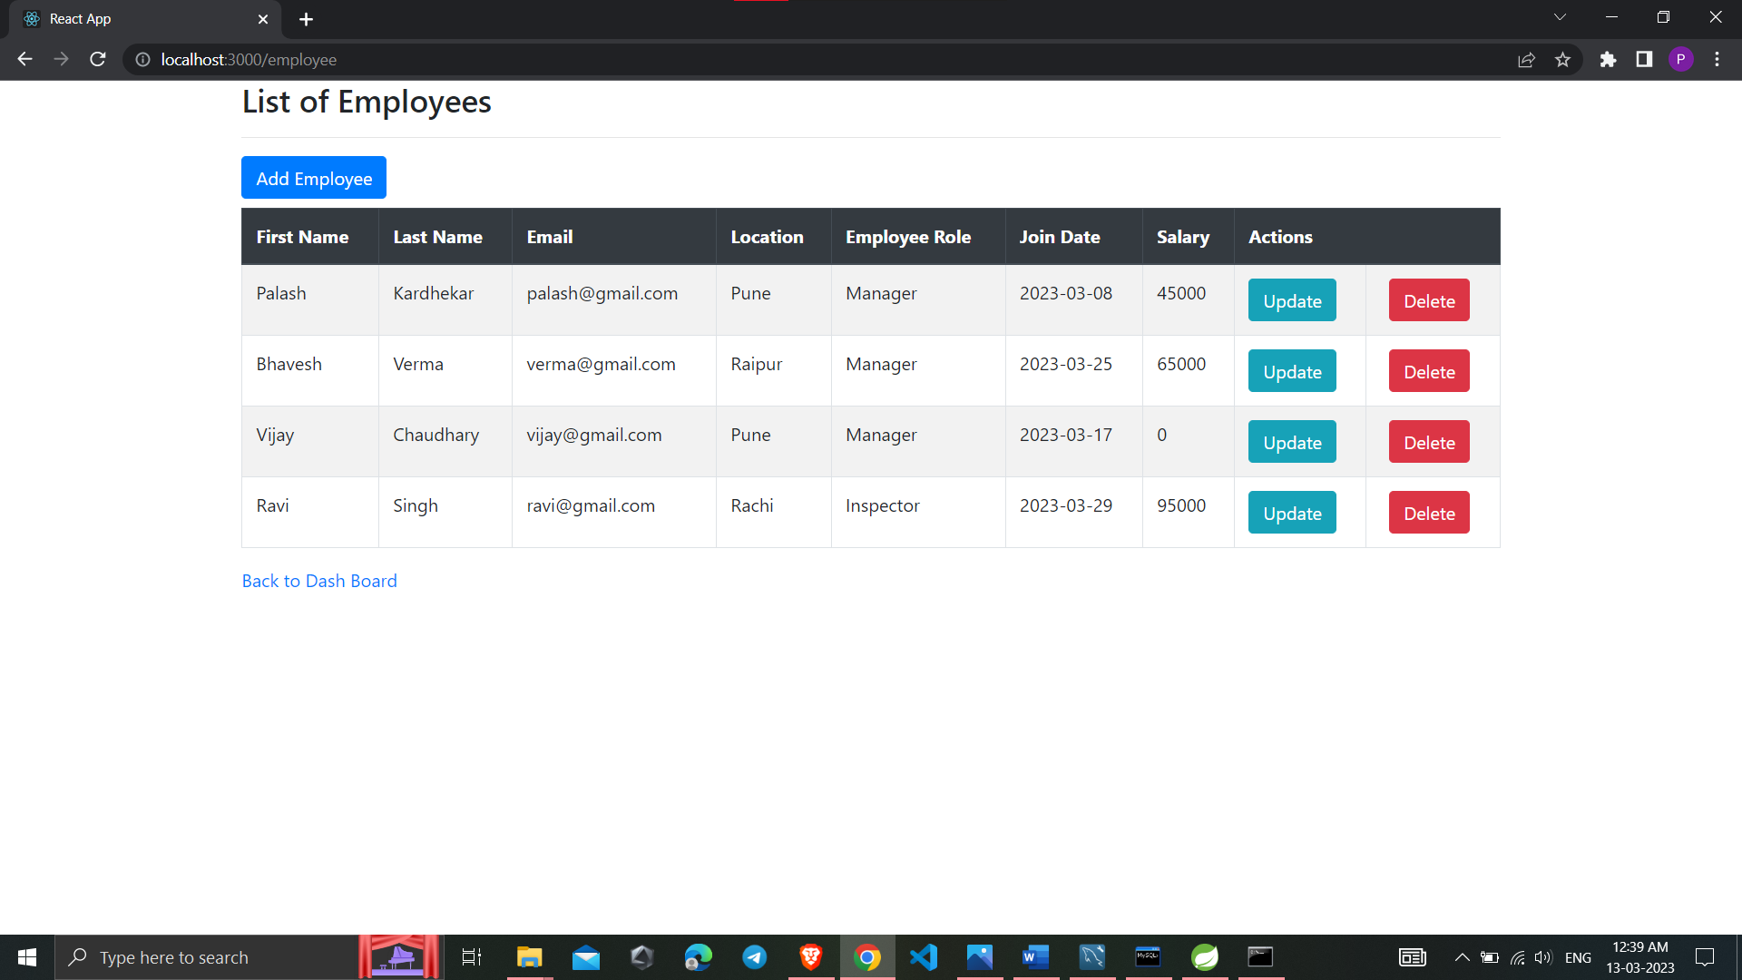
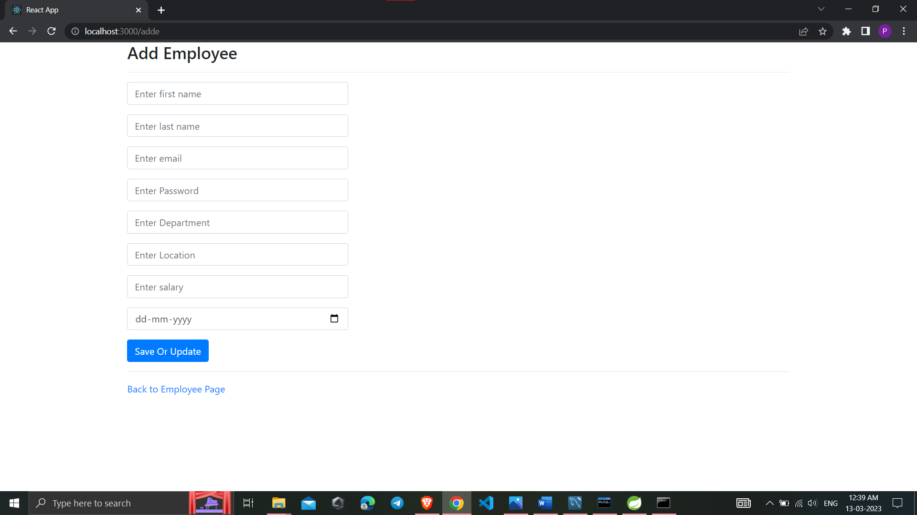
← List of Employees
Add Employees →

Slide 19
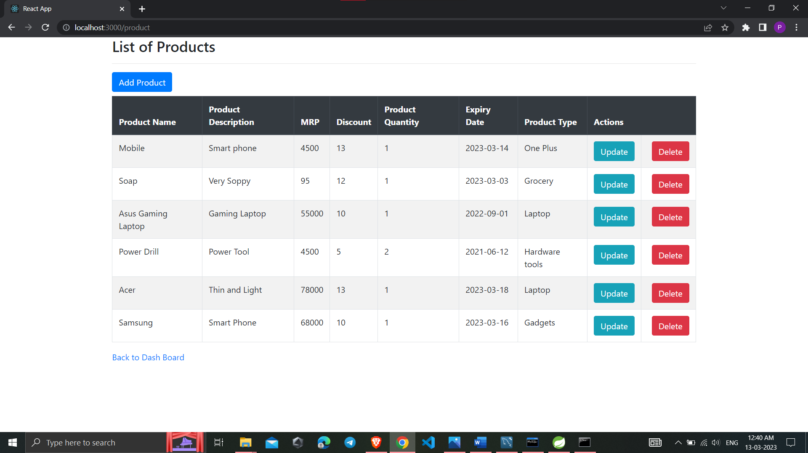
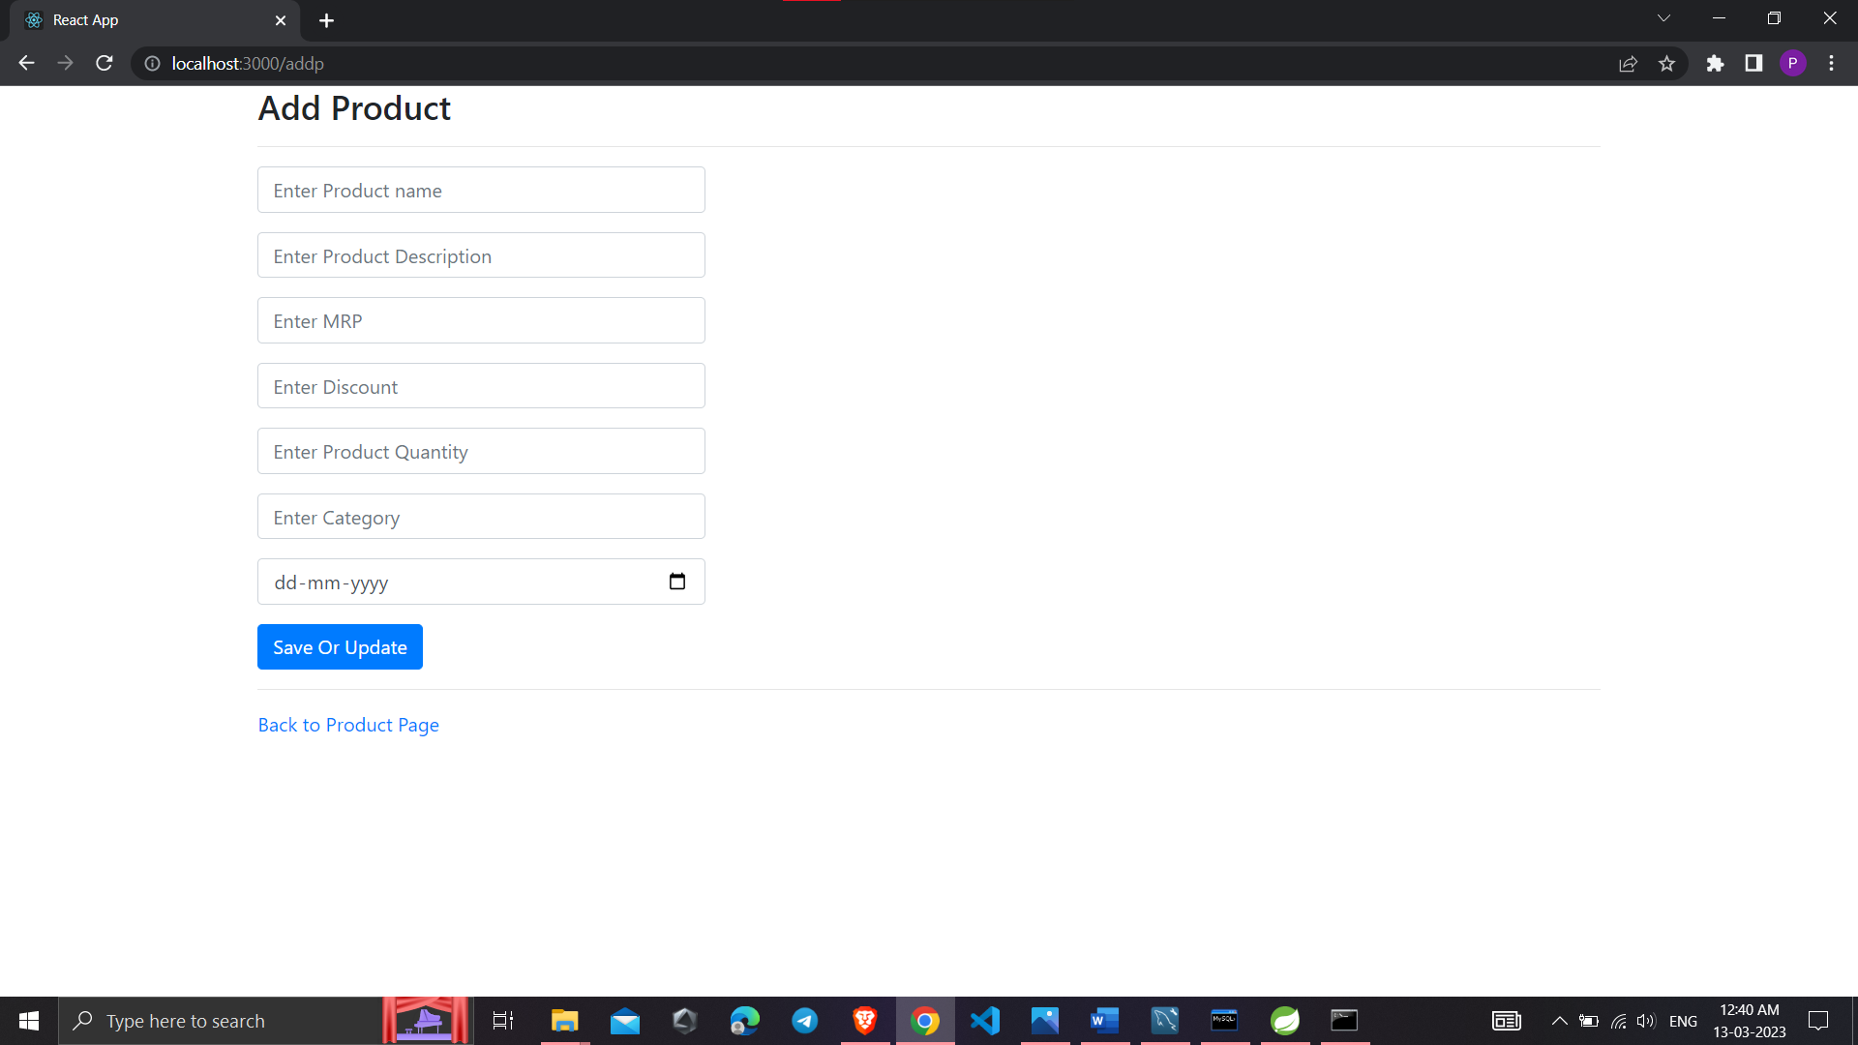
← List of Products
Add Product →

Slide 20
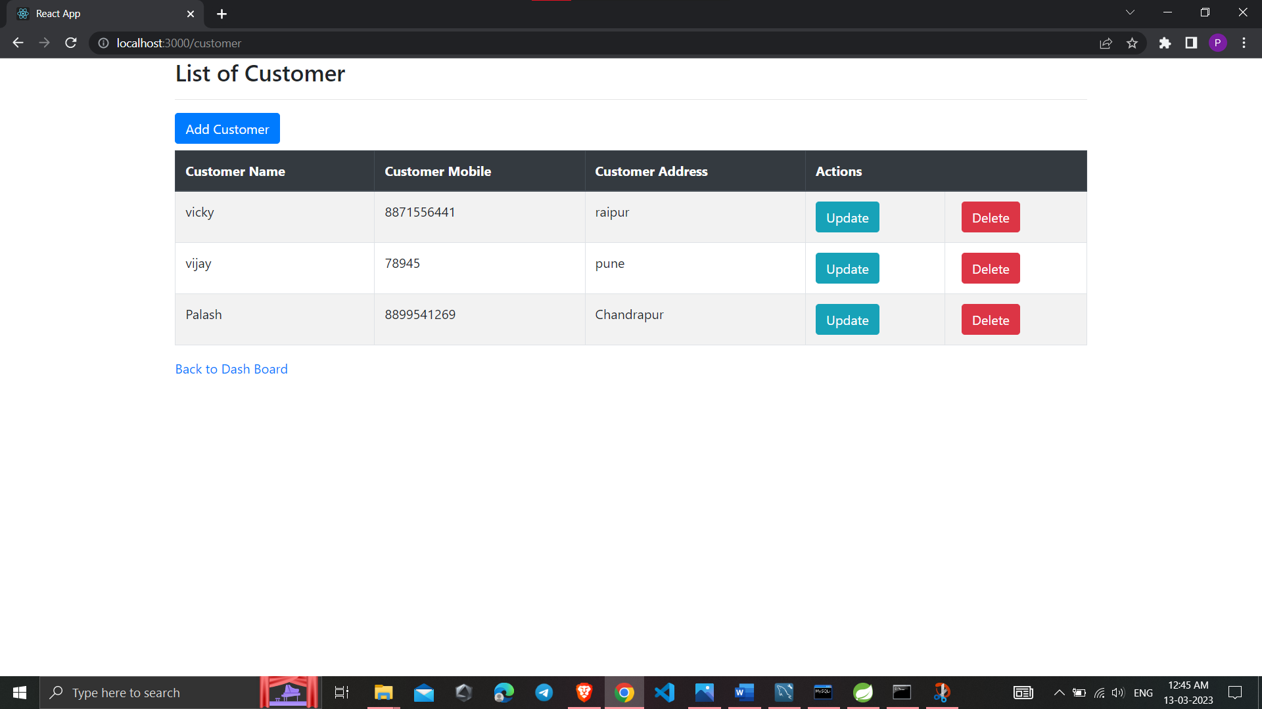
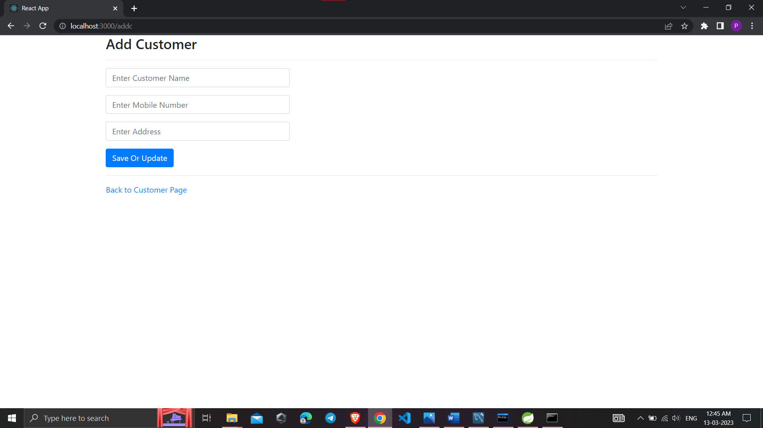
← List of Customer
Add Customer →

Slide 21
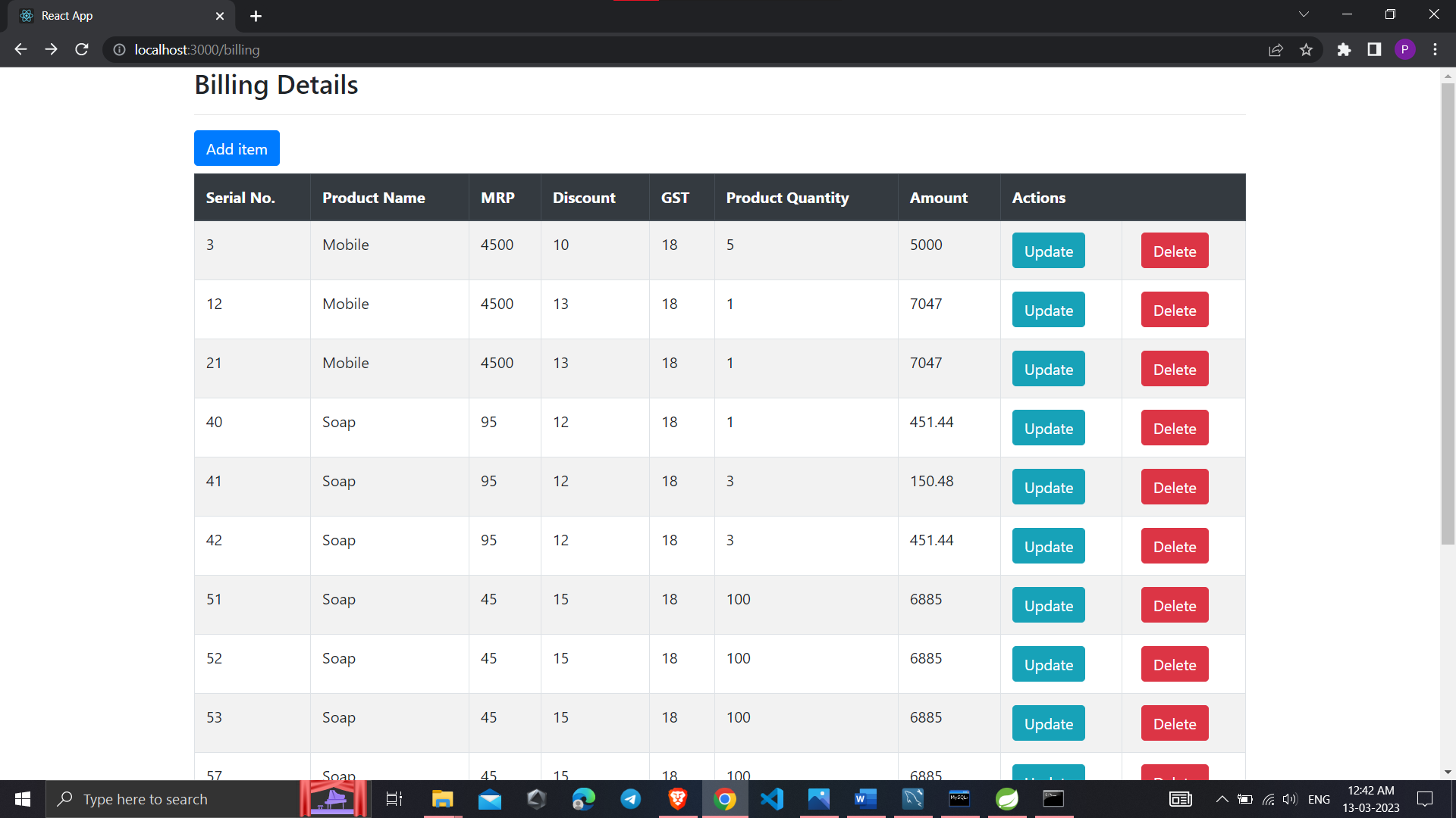
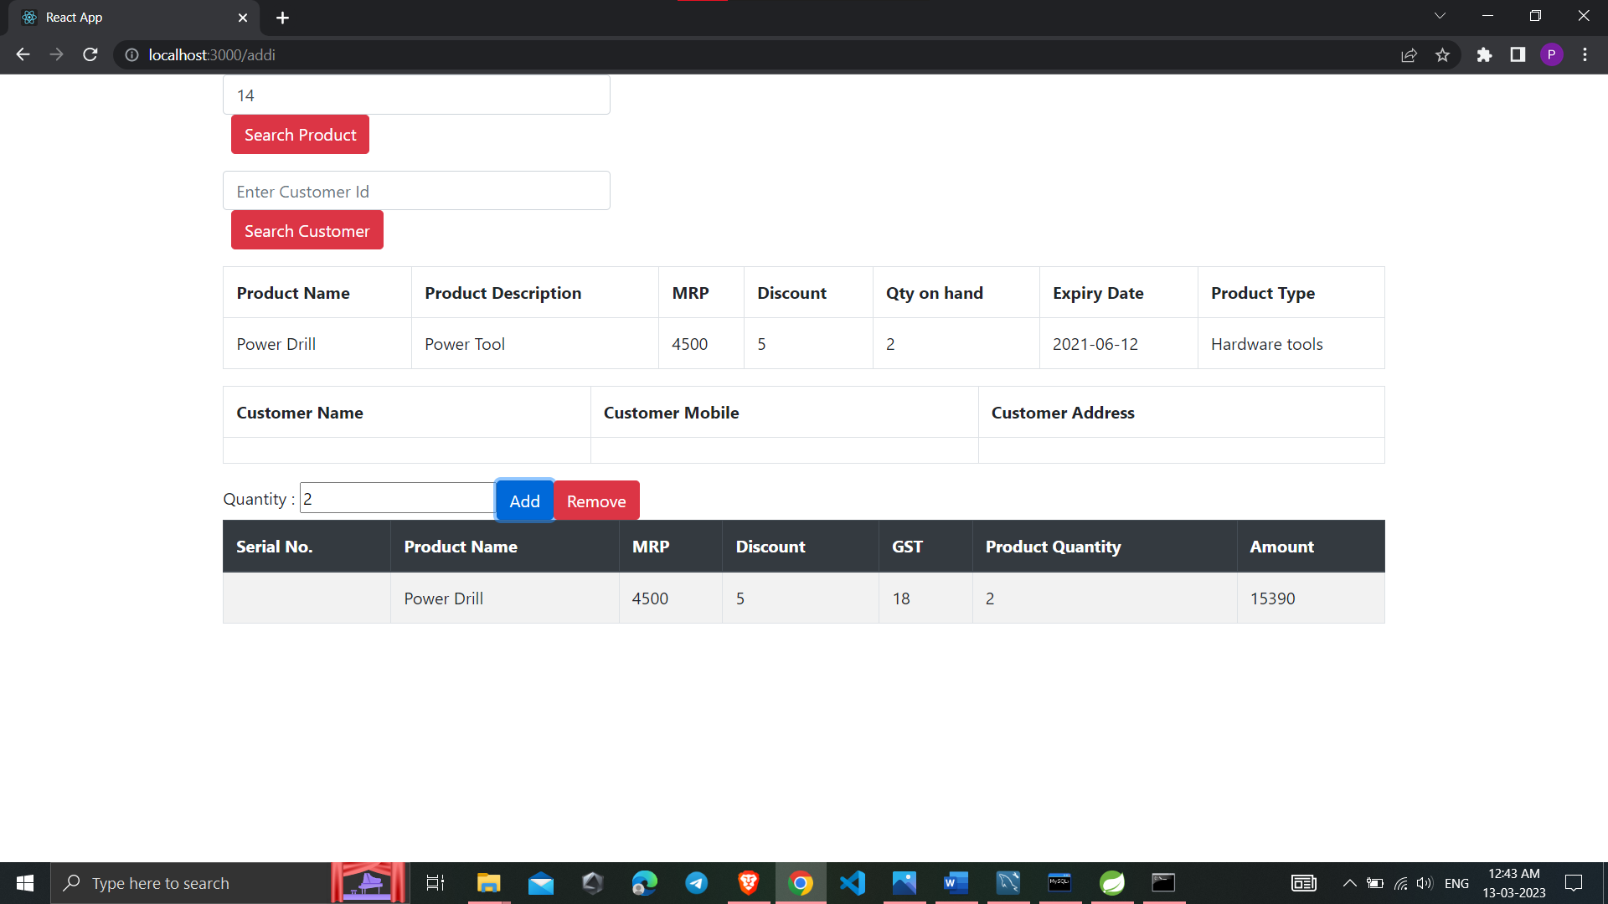
← Bill Details
Search Product and add into Bill Details →

Slide 22
Specification
The application will use JavaScript, jQuery and CSS as main web technologies.
HTTP and FTP protocols are used as communication protocols. FTP is used to upload the web application in live domain and the client can access it via HTTP protocol.
SMTP protocol is used for Email communication.
Several types of validations make this web application a secured one and SQL Injections can also be prevented.
Since Mart Inventory Application is a web-based application, internet connection must be established.
The Mart Inventory Application will be used on PCs and will function via internet or intranet in any web browser.

Slide 23
S/W and H/W Requirements
Server Side:
Processor: Intel® Xeon® processor 3500 series
HDD: Minimum 500GB Disk Space
RAM: Minimum 4GB
OS: Windows 10, Linux 6
Database: MySQL
Client Side (minimum requirement):
Processor: Intel Dual Core
HDD: Minimum 10GB Disk Space
RAM: Minimum 2GB
OS: Windows 7, Linux

Slide 24
Advantages
Managing Product information.
Effortless Communication.
Lesser time requirement to maintain and manage records of Products, Customers and Sales person.
Automatic bill generation of day to day transactions.
Paper work is reduced due to record stored into excel sheets.
All requirements at one platform.

Slide 25
Disadvantages
Manual entry of products into catalog has to be done by sales person or manager.
No online payment facility given, hence payment must be done manually. But this can be done as future enhancement.

Slide 26
Conclusion
This project aid in automating the existing manual system. This is a paperless work. It can be monitored and guarded remotely. It cut down the man power required and provides accurate information. All years together huddled details can be saved and can be accessed at any time. For this reason, the data stored in the repository helps in taking decision by management. So, it is improved to have a Web Based system. All the sales person, manager and owner can get the required information without delay. This system is crucial in the mart and groceries.

Slide 27
Future Enhancement
This project can be enhanced further by adding payable additional specific features such as online feedback system, online product query related to particular products to reduce the extra work of the admin. The software is flexible enough to be modified and implemented as per future requirements. We have tried our best to present this free and user–friendly website to Various Mart owners.

Slide 28
References
https://bootstrapmade.com/mentor-free-education-bootstrap-theme/
https://www.javatpoint.com/java-mail-api-tutorial
https://www.w3schools.com/
https://reactjs.org/
https://javaee.github.io/javaee-spec/javadocs/

Slide 29
THANK YOU

